Slide 1
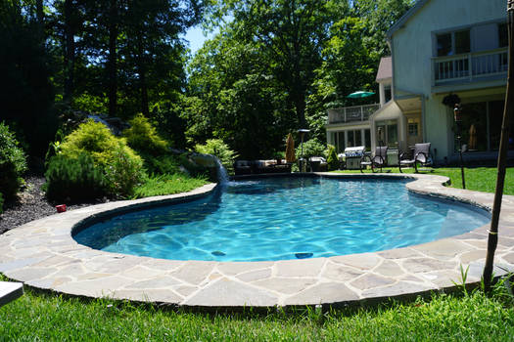
Joe’s Pool Service
Name: Joe Hernandez, Teacher: Maren Anton

Slide 2
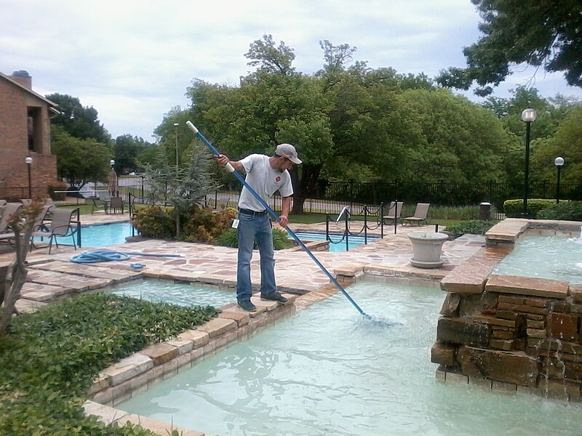
Answer these questions with bullet points and pictures. 2. Summary: What is the business? What kind of business is it? What does the business do or make?
My name is Joe Hernandez. I plan to open my own pool cleaning business. I will provide weekly pool cleaning services, deep cleaning services, and various repairs of pool equipment.

Slide 3
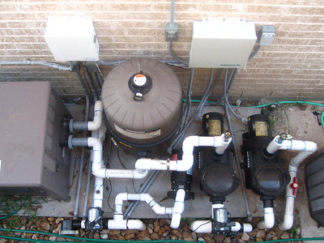
Answer these questions with bullet points and pictures.
3. Budget: How much will you charge for your service or product?
I will charge $50 a week for regular pool cleaning services.
Deep cleaning or pools that are not regularly cleaned will cost $150 to $200, depending on the condition of the pool.
Repairs will also cost more, since that would require additional equipment to be bought and installed. For example, a pool pump replacement will cost $250 to $300 for parts and labor.
Pool Pump System

Slide 4
Answer these questions with bullet points and pictures.
4. Market Analysis: Why did you choose this business? Why do you think this business will be successful? Name two reasons.
I have worked for a pool company for 10 years. I am good at cleaning pools. Then I learned how to fix the pool equipment. I am good at talking with customers and I really enjoy my job. I have both experience and passion for this business.
My business will be in Danville, CA because there are a lot of customers in Danville with large pools. Also, I believe I can give my customers excellent service.

Slide 5
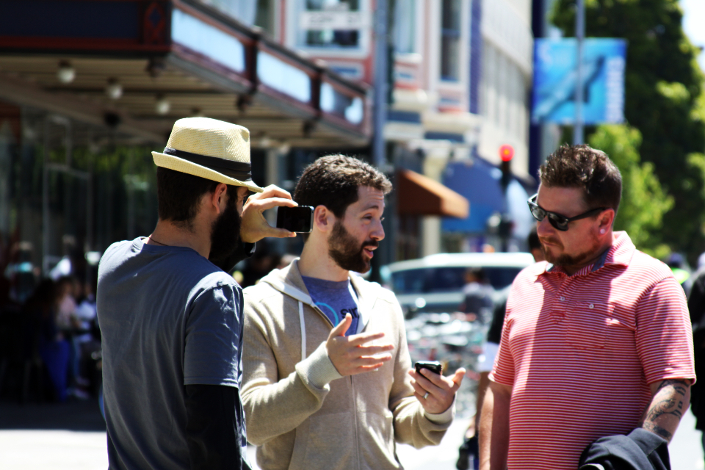
Answer these questions with bullet points and pictures.
5. Marking Plan and Sale Strategies: How will you advertise your business? How will customers learn about your product or service? How will your item be sold?
I have a big plan for marketing. I made YouTube videos of how I clean and fix pools. I explain everything in my videos. I put those videos on my Business Instagram page.
I took a lot of pictures of beautiful pools that I cleaned as well. I’ll post them on Facebook, Instagram, SnapChat, and Twitter.
Also, my customers will spread my business through word of mouth. They will talk to their friends and recommend my business to co-workers too.

Slide 6
Answer these questions with bullet points and pictures.
6. Resources Needed: How many employees are needed? What are their responsibilities/ roles/ positions or job titles, hours, and wages? Are you the only employee? If so, what are your hours and responsibilities? What resources do you need to start or maintain this business? How much money will you need to start your business? Make a list below. $$, equipment, permits, etc. (check www.calgold.ca.gov for required permits)
I am going to work alone in my business for now. I don’t have enough money yet to hire other employees. I’m going to do all the work now, but later I will hire someone to help me repair pools that are broken.
Before I can open my business, I need to get a pool cleaning permit. I also need to pay the government to register my fictitious business name (Joe’s Pool Services).
I also need to buy the chemicals and pay for business cards.

Slide 7
7. Contact Information: Where is it located? What are the business hours? What is your contact information?
The business will be located in Danville, CA.
The business hours and days will be from Monday to Saturday, 8:00 AM to 6:00 PM. I can work for emergency situations on Sundays or holidays, but I will charge more money.
My contact information is:
joespoolservices2023@gmail.com
(434) 123-4567
1222 Alexander Lane
Danville, CA 94506

