Slide 1
Introduction
Maria’s Catering
(Name: Maria Lopez, Teacher: Maren Anton)

Slide 2
Answer these questions with bullet points and pictures.
2. Summary: What is the business? Describe what the business does or makes (landscaping, restaurant, etc.) and how much will you charge for your service or product.
I want to have a catering business in my home. I want to cook for people.
They can come to my house and pick up the food for their families or parties. I can also bring the food to people. I will cook Mexican food.
The cost will be $15 to $20 per person. So, a family meal for 4 people will cost $60 to $80.

Slide 3
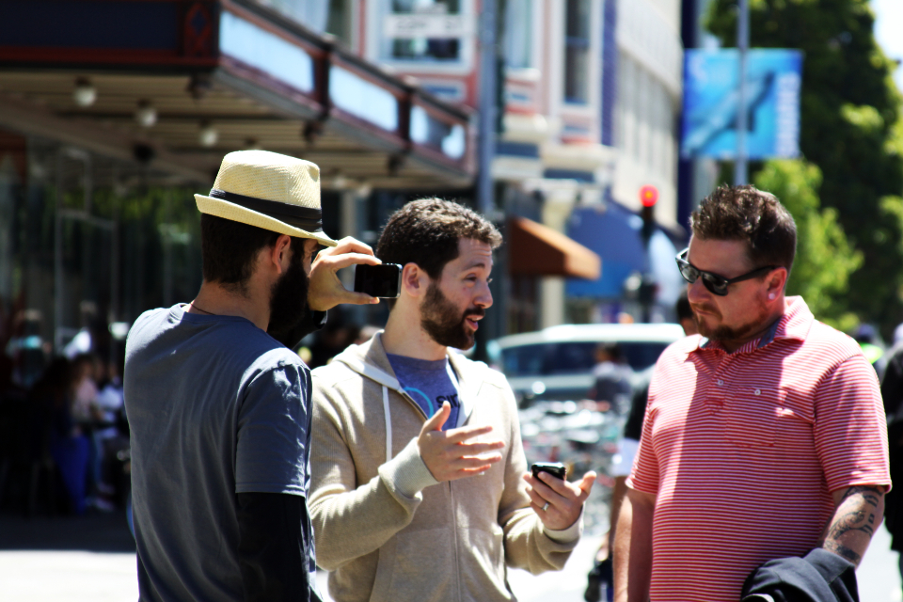
Answer these questions with bullet points and pictures.
3. Market Analysis, Plan and Sale Strategies: Why did you choose this business? Why do you think this business will be successful? How will you advertise your business?
I am passionate about cooking. I love to cook. I can make people happy with my cooking because everyone likes how I cook.
Many people are busy. If they don’t have time to cook, I can prepare a beautiful Mexican meal for them.
I will advertise on Facebook or Instagram. I will tell my neighbors too and they tell their friends. I like word of mouth advertising.

Slide 4
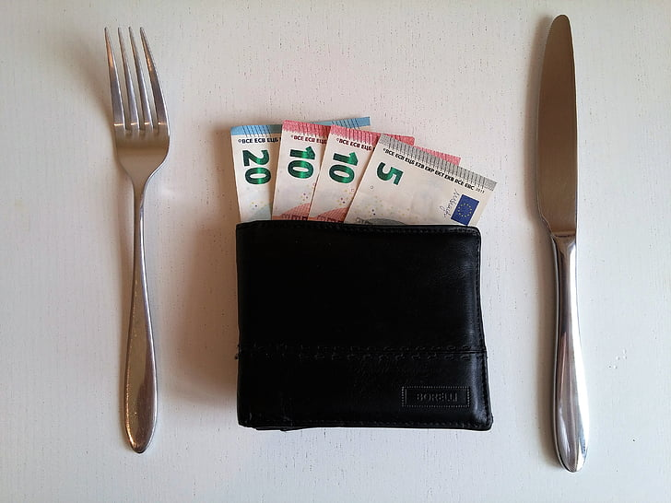
Answer these questions with bullet points and pictures.
4. Resources Needed: How many employees are needed (if any)? What are their responsibilities/ roles/ positions or job titles, hours, and wages?
Or
How much money do you think you need to start this business? Equipment, permits?
I will cook by myself, I think. Maybe if I make a lot of money, I will hire someone to help me cook and package the food.
I have pots and pans and other cooking supplies.
I will need to buy the food and packages. I will probably need $500 to start my business.

Slide 5
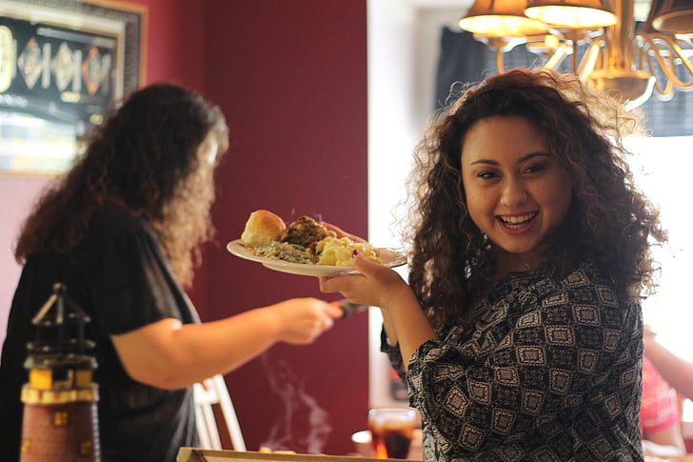
5. What is your contact Information?
My business email: mariascatering@cook.com
Phone number: (510) 787-2356
Days and hours of operation: Saturday to Monday from 8 am to 5 pm
Business Address: 1266 San Carlos Ave.
Concord, CA 94518

